Slide 1
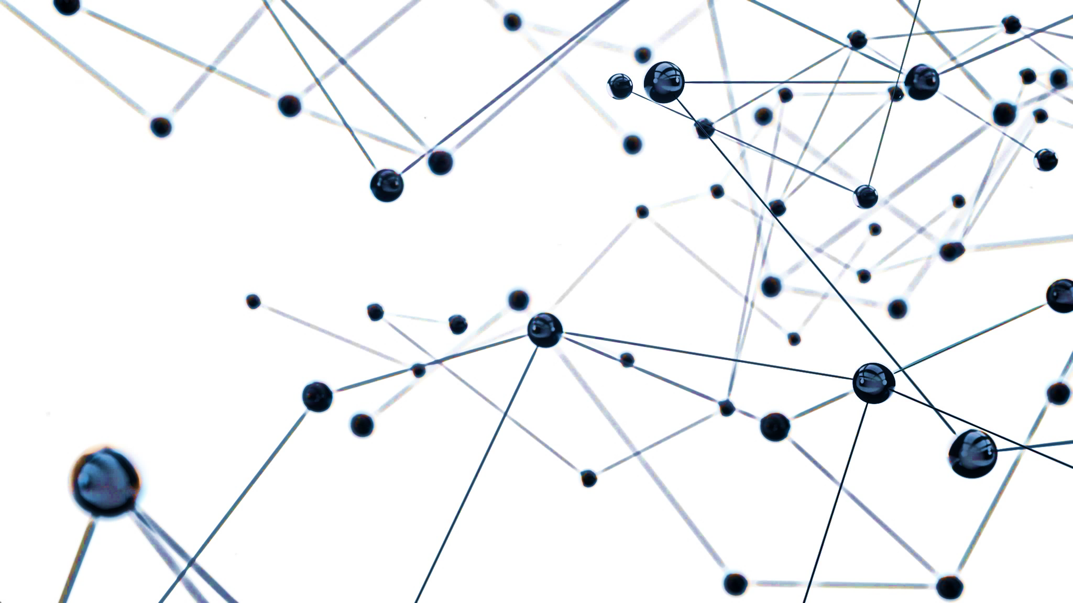
Phonon Momentum Group : Theory & Python Fitting
Akhil Sadam

Slide 2
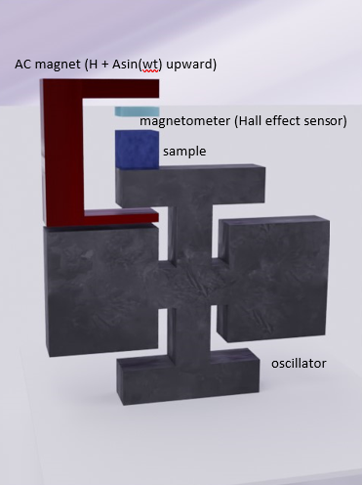
Theory & Experiment

Slide 3
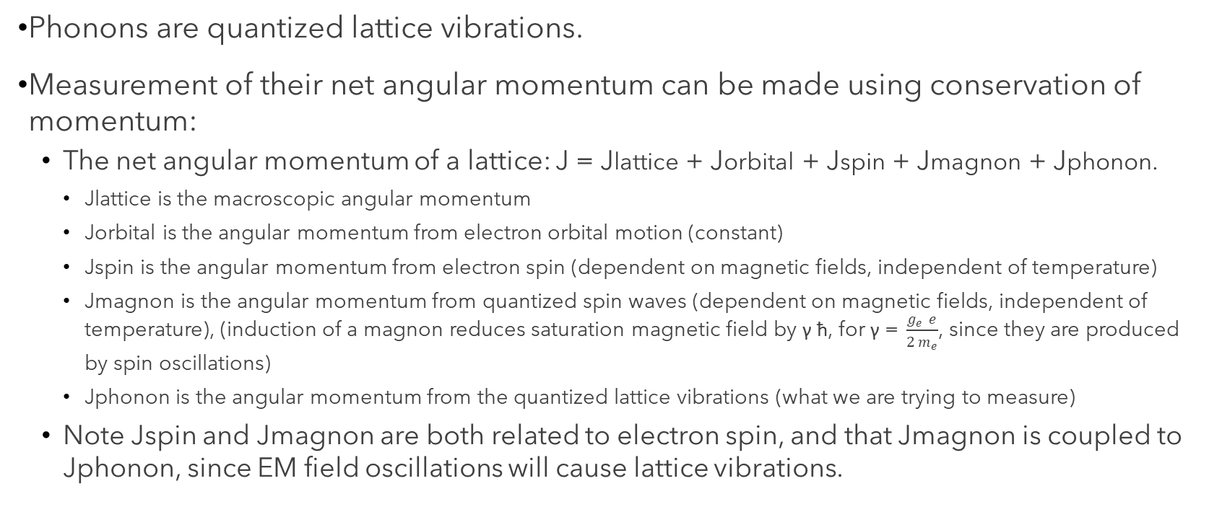
Theory
Phonons are quantized lattice vibrations.
Measurement of their net angular momentum can be made using conservation of momentum:
The net angular momentum of a lattice: J = Jlattice + Jorbital + Jspin + Jmagnon + Jphonon.
Jlattice is the macroscopic angular momentum
Jorbital is the angular momentum from electron orbital motion (constant)
Jspin is the angular momentum from electron spin (dependent on magnetic fields, independent of temperature)
Jmagnon is the angular momentum from quantized spin waves (dependent on magnetic fields, independent of temperature), (induction of a magnon reduces saturation magnetic field by γ ћ, for γ =$\frac{g_{e} e}{2 m_{e}}$, since they are produced by spin oscillations)
Jphonon is the angular momentum from the quantized lattice vibrations (what we are trying to measure)
Note Jspin and Jmagnon are both related to electron spin, and that Jmagnon is coupled to Jphonon, since EM field oscillations will cause lattice vibrations.

Slide 4
Theory
By inducing a spin change, ΔJphonon can be extracted via measurement of ΔJlattice above and below the Debye temperature. There will be an induced ΔJmagnon and ΔJphonon as well, since magnons are quantized spin waves and thus respond to spin changes, and phonons are coupled to magnons.
Then ΔJlattice = - (ΔJspin + ΔJmagnon + ΔJphonon.)
Above Debye Temperature:
ΔJlattice1 + ΔJspin = - ΔJmagnon, as Jphonon has a classical limit of 0.
Below Debye Temperature:
ΔJlattice2 + ΔJspin = - (ΔJmagnon + ΔJphonon.)
Comparing these two measurements will allow us to identify the ΔJphonon by removing the ΔJmagnon and ΔJspin contributions, since they are the same in both cases.

Slide 5
Experiment
We plan to induce electron spin changes through an oscillating external magnetic field. A magnetometer (Hall effect sensor) (optional) may be used to confirm that the number of magnons induced are equivalent in both measurements by measuring magnetization.
Measurement of ΔJlattice will be done by measuring angular deflection of the mounted sample.
To increase sensitivity:
The sample will be mounted upon a high-Q double torsional oscillator
Angular deflection torque measurements will be done with both fiber-optic interferometry and capacitive detection
The sample will be chosen as to reduce induced eddy current momentum.

Slide 6
Estimates
Null Hypothesis: Estimate of ΔJlattice assuming no magnon or phonon angular momentum
Order of magnitude estimate of phonon angular momentum for MgZn
Induced eddy current momentum estimate
Thermal noise limit and force sensitivity estimates (not calculated here – done by Mr. Matthew Dwyer)

Slide 7
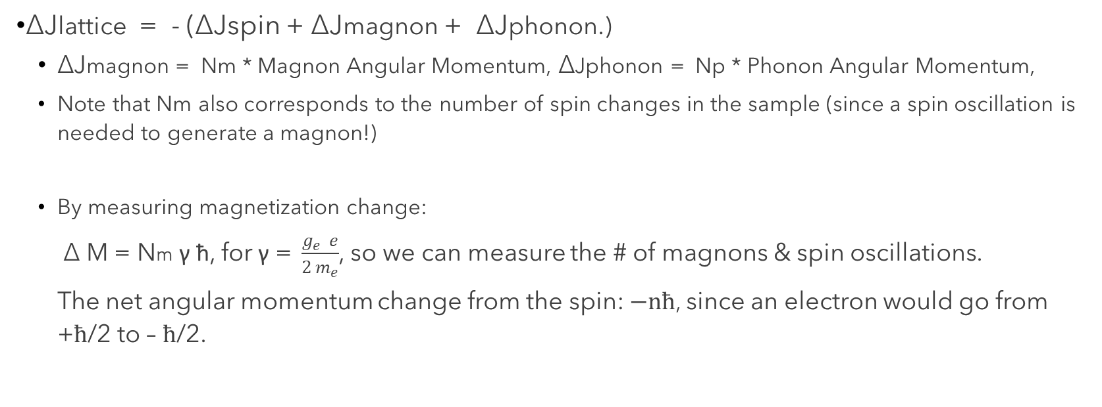
Estimates: Null Hypothesis
ΔJlattice = - (ΔJspin + ΔJmagnon + ΔJphonon.)
ΔJmagnon = Nm * Magnon Angular Momentum, ΔJphonon = Np * Phonon Angular Momentum,
Note that Nm also corresponds to the number of spin changes in the sample (since a spin oscillation is needed to generate a magnon!)
By measuring magnetization change:
Δ M = Nm γ ћ, for γ =$\frac{g_{e} e}{2 m_{e}}$, so we can measure the # of magnons & spin oscillations.
The net angular momentum change from the spin: $−nћ$, since an electron would go from +$ћ$/2 to – $ћ$/2.

Slide 8
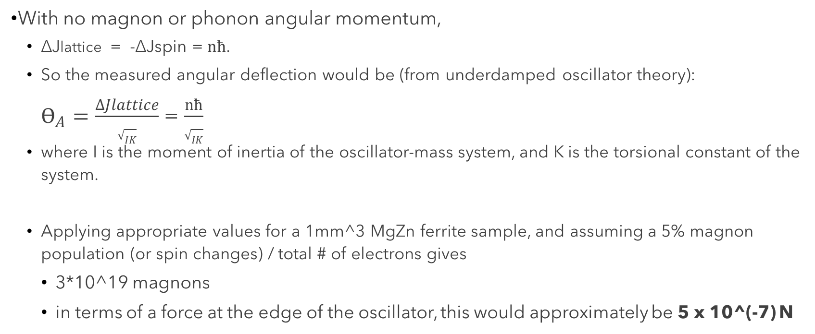
Estimates: Null Hypothesis
With no magnon or phonon angular momentum,
ΔJlattice = -ΔJspin = $nћ$.
So the measured angular deflection would be (from underdamped oscillator theory):
$ϴ_{A}=\frac{∆Jlattice}{\sqrt{IK}}$ = $\frac{nћ}{\sqrt{IK}}$
where I is the moment of inertia of the oscillator-mass system, and K is the torsional constant of the system.
Applying appropriate values for a 1mm^3 MgZn ferrite sample, and assuming a 5% magnon population (or spin changes) / total # of electrons gives
3*10^19 magnons
in terms of a force at the edge of the oscillator, this would approximately be 5 x 10­^(-7) N

Slide 9
Estimates: Null Hypothesis
Note that we have not yet quantified the # of phonons (Np) produced! (This will be related to the temperature.)
Also note that this is only a rough estimate of the magnitude of the phonon effect – we will need to make a direct estimate from Dr. Niu’s paper.
With a thermal noise of 6 x 10⁻¹⁴ N/sqrt{Hz} (from Dr. Wei Lu’s paper), and a force sensitivity of:
Capacitive detection: 10⁻⁸ N/sqrt{Hz}
Interferometer detection: 2 x 10⁻¹¹ N/sqrt{Hz},
We can see that the force (5x10­⁻⁷ N) would be easily detectable.

Slide 10
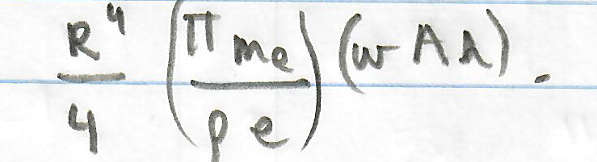
Estimates: Induced Eddy Current
From Faraday’s law applied on a cylinder (not shown here), the net induced eddy current can be estimated to be approximately:
R: the radius of the cylindrical sample (~1*10^-3)
A: the magnetic field’s AC amplitude (8T)
h: the height of the cylindrical sample (~1*10^-3)
p: resisitivity
w: 9000Hz at resonance
So p ~ 4x10^6 (order of magnitude estimate) to have the same magnitude of angular momentum as the phonon/magnon effects.

Slide 11
Python Fitting
Current Fits
Next: Radial Fits

Slide 12
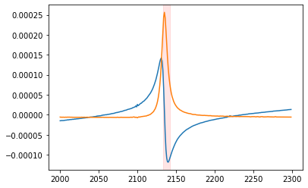
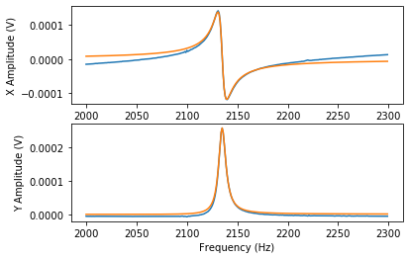
Fits
An example fit:
Peak 1 of 1 at 2134.8315720812807 Hz
ABSORPTION AMPLITUDE: 0.025833302480915782 V
ELASTIC AMPLITUDE: 0.025833302480915782 V
RESONANCE AMPLITUDE: -4.7254017387085305 V
RESONANCE QUALITY: 248.0307084952861
Clearly the background is not yet fit properly – radial fits will be tried next.

